Slide 1
Design of Autonomous Food Delivery Vehicle
Kevin Harper , Montraz Oliver , and Eli Nbede

Slide 2
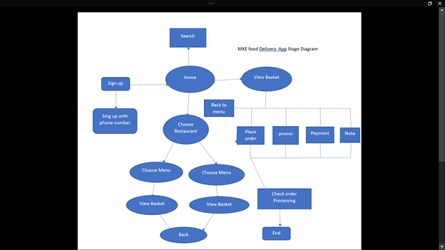
App Stage diagram

Slide 3
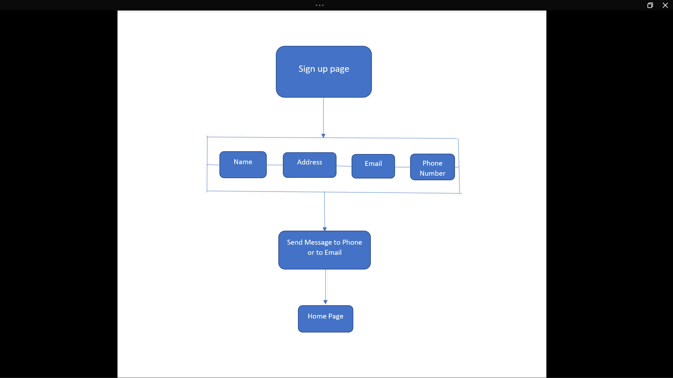
Sign up Page Diagram

Slide 4




Detection - software

Slide 5
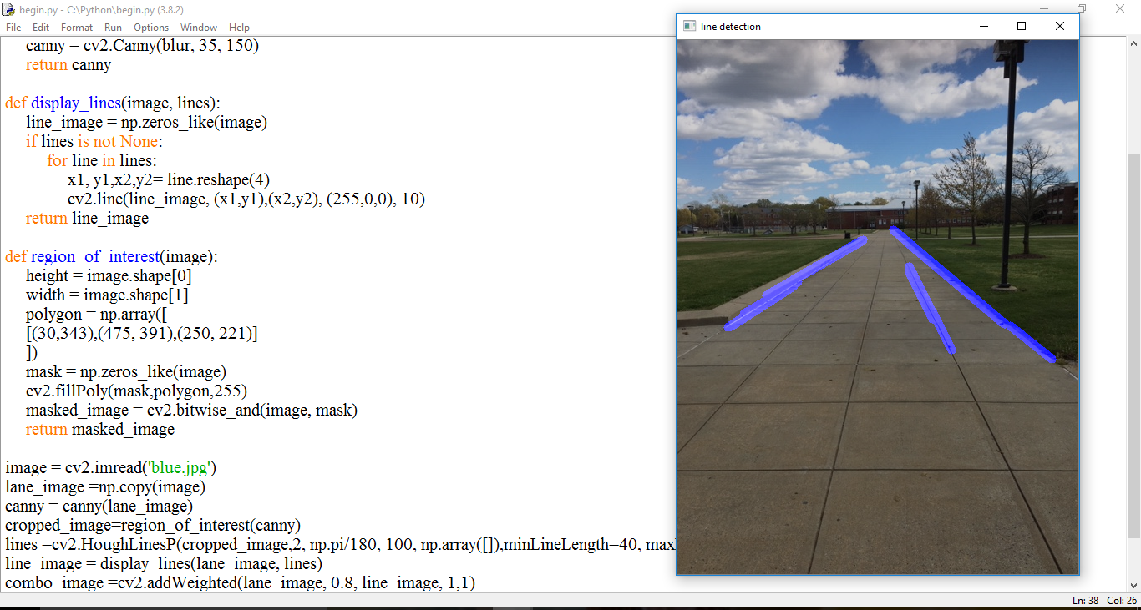

Slide 6
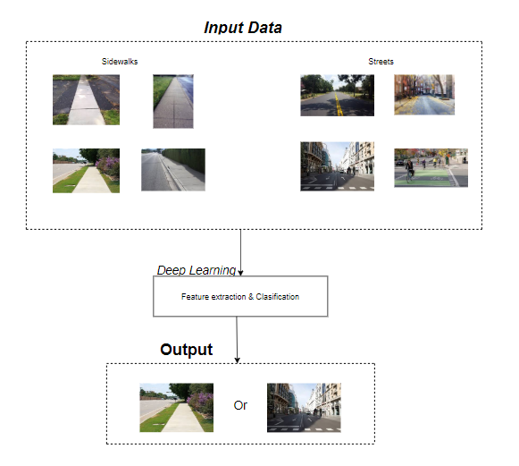
Neural Network Design Process

Slide 7
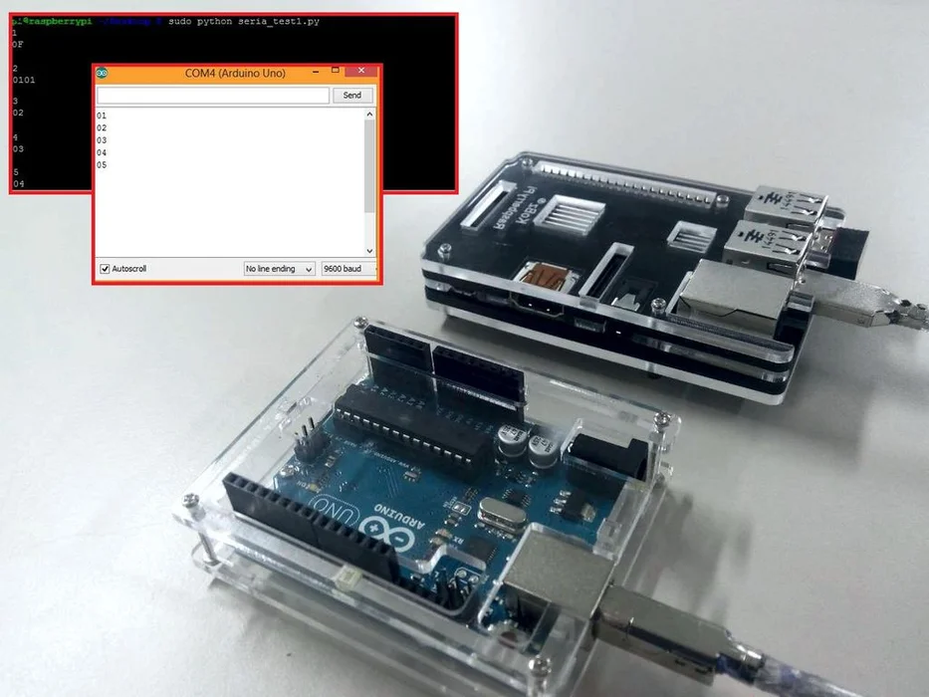
Serial communication

Slide 8
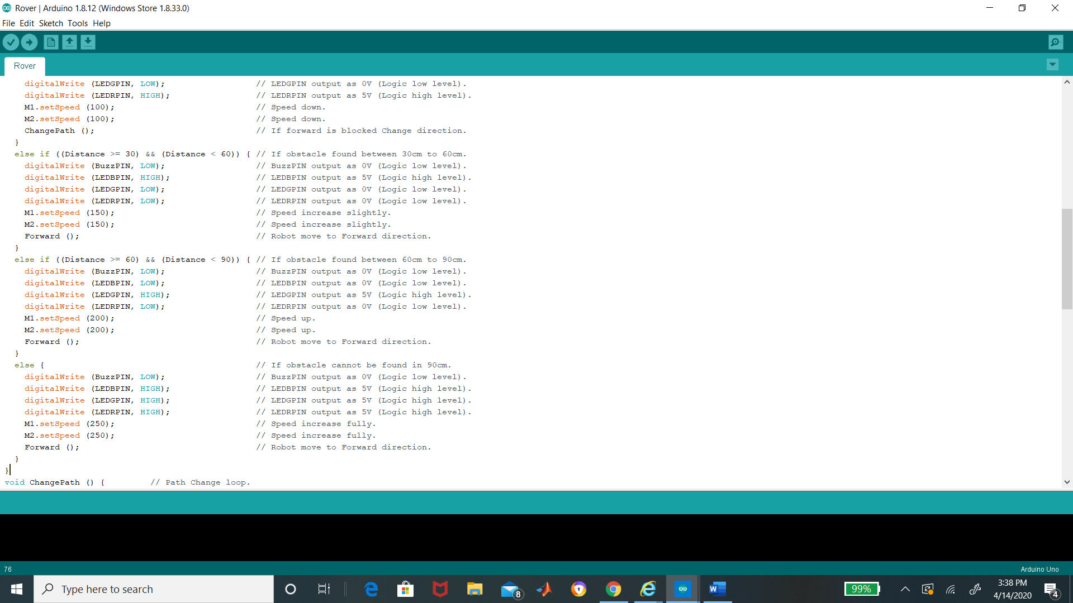
Using Arduino for vehicle movement

